Slide 1

GLOBAL POWER PLATFORM BOOTCAMP
Organized Globally, Held Locally
@GPPBootcampBLR #GPPBootcampBLR #GlobalPowerPlatformBootcamp

Slide 2

Power BI Rookie to Pro
Basavaraj Biradar
Software Architect
@sqlhints
@GPPBootcampBLR #GPPBootcampBLR
#GlobalPowerPlatformBootcamp

Slide 3



Sponsors

Slide 4
Agenda
What is Power BI?
Power BI components and workflow
Demo
Query Editor - The Kitchen of Power BI
Relationships and DAX - The Heart of the Power BI
Creating beautiful Power BI Reports – The Eyes of Power BI
Publish Reports and use it on PowerBI.com

Slide 5
What is Power BI?

Slide 6
Power BI Components and general Workflow

Slide 7
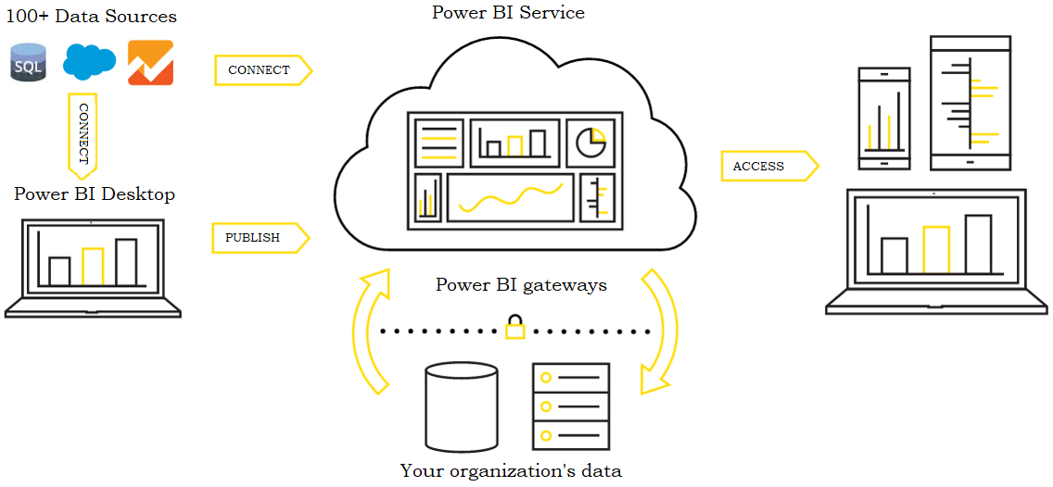

Slide 8
Demo

Slide 9
Any Questions?

Slide 10
References
Demo Coronavirus data source
https://github.com/CSSEGISandData/COVID-19
https://gisanddata.maps.arcgis.com/apps/opsdashboard/index.html#/bda7594740fd40299423467b48e9ecf6

Slide 11
Building Custom Visuals using R/Python in Power BI
Next Session:
Madhan K
Lead Consultant, Tarento Technologies

